Slide 1
Variance
Variance = How far are data points from their mean?
High variance = Data is more scattered from its mean
Low variance = Data is less scattered from mean
Variance calculation:
Find the mean of the given data set
Subtract the mean from each value and square the result
The average of these squared values is the variance

Slide 2
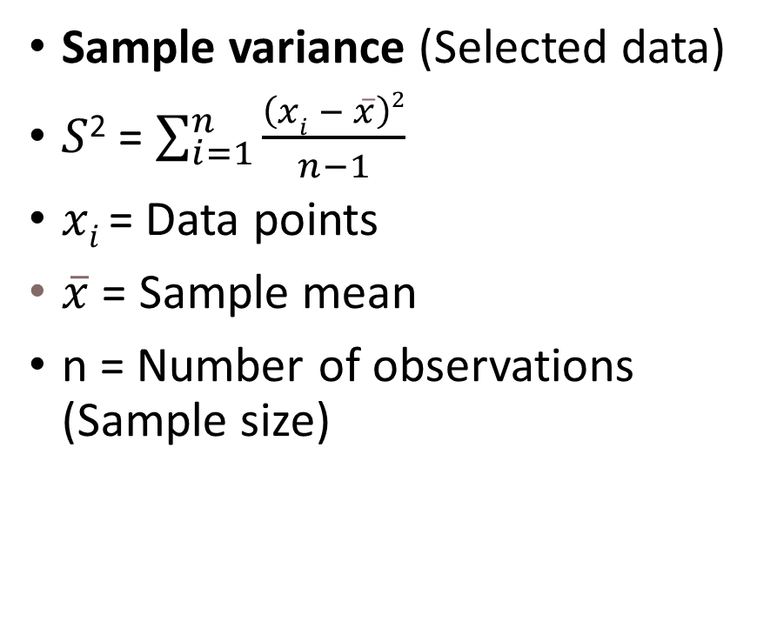
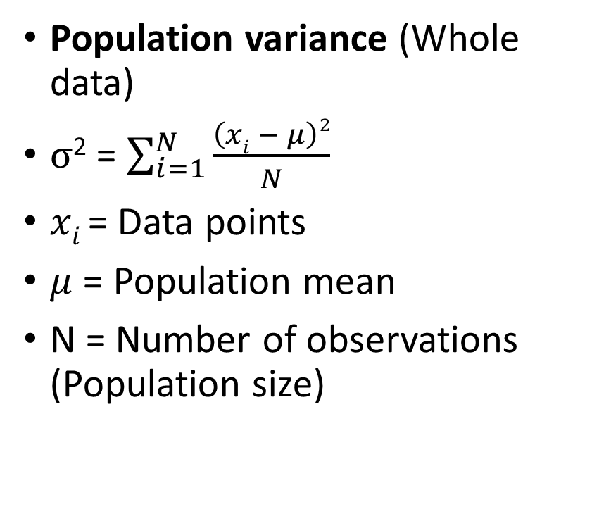
Variance Formula
Population variance (Whole data)
$σ$² = $\sum_{i=1}^{N}{\frac{\left(xi − μ\right)2}{N}}$
$xi$= Data points
$μ$ = Population mean
N = Number of observations (Population size)
Sample variance (Selected data)
$S$² = $\sum_{i=1}^{n}{\frac{\left(xi − \overline{x}\right)2}{n−1}}$
$xi$= Data points
$\overline{x}$ = Sample mean
n = Number of observations (Sample size)

Slide 3
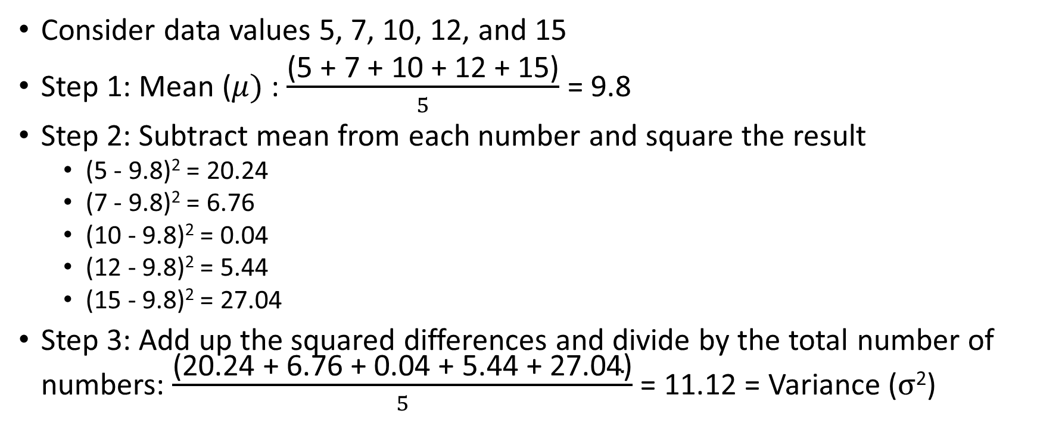
Variance Example
Consider data values 5, 7, 10, 12, and 15
Step 1: Mean ($μ)$: $\frac{\text{(5 + 7 + 10 + 12 + 15)}}{5}$ = 9.8
Step 2: Subtract mean from each number and square the result
(5 - 9.8)² = 20.24
(7 - 9.8)² = 6.76
(10 - 9.8)² = 0.04
(12 - 9.8)² = 5.44
(15 - 9.8)² = 27.04
Step 3: Add up the squared differences and divide by the total number of numbers: $\frac{\text{(20.24 + 6.76 + 0.04 + 5.44 + 27.04)}}{5}$ = 11.12 = Variance ($σ$²)

Slide 4
Why are the Differences Squared?
If we do not do this, then the positive and negative differences may cancel each other and we may not be able to find how the data points are dispersed from the mean
Example: Consider marks of 5 students: 55, 60, 65, 54, 64
Mean: 59.6, Variance: 20.24
But if we do not square the differences, what will happen?
Marks | Marks - Mean | (Marks - Mean) Squared
55 | -4.6 | 21.16
60 | 0.4 | 0.16
65 | 5.4 | 29.16
54 | -5.6 | 31.36
64 | 4.4 | 19.36
Mean | (Marks - Mean) / 5 | ((Marks - Mean) Squared)) / 5
59.6 | 0.00 | 20.24
Variance

Slide 5
Limitation of Variance: How to Quantify?
Quantifying/measuring variance is tough
Example: Consider marks of 10 students: 32, 39, 44, 56, 56, 63, 71, 72, 81, 89
Mean: 60.3, Variance: 306.81
Variance seems to be high, but it does not convey any meaningful information beyond this
This is a limitation of variance

Slide 6
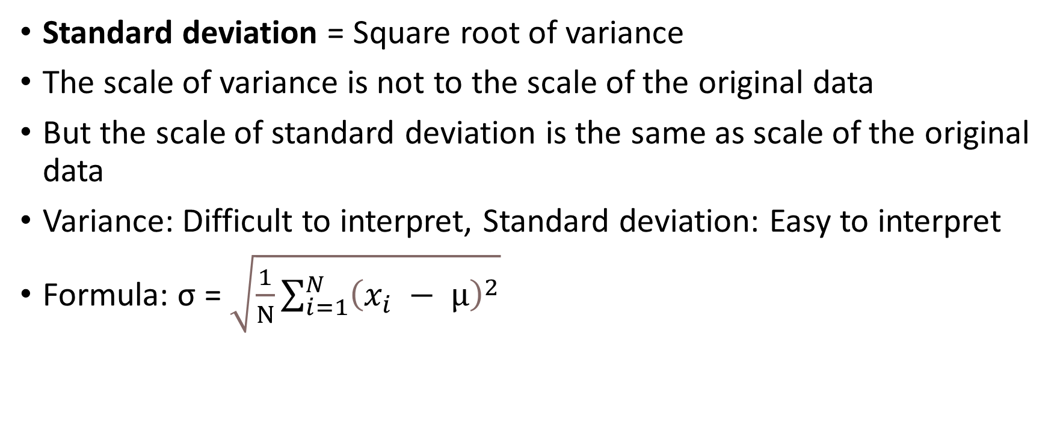
Standard Deviation
Standard deviation = Square root of variance
The scale of variance is not to the scale of the original data
But the scale of standard deviation is the same as scale of the original data
Variance: Difficult to interpret, Standard deviation: Easy to interpret
Formula: σ = $\sqrt{\frac{1}{N}\sum_{i=1}^{N}{{\left(x_{i} − μ\right)}^{2}}}$

Slide 7

Standard Deviation Example
Marks of 10 students: 76, 89, 53, 75, 80, 67, 61, 59, 71, 60
Mean ($μ$): $\frac{\text{76 + 89 + 53 + 75 + 80 + 67 + 61 + 59 + 71 + 60}}{ 10}$ = $\frac{691}{10}$ = 69.10
Standard deviation (σ) = $\sqrt{111.49}$ = 10.56
Deviation | Deviation Squared
76 – 69.10 = 6.9 | 47.61
89 – 69.10 = 19.9 | 396.01
53 – 69.10 = -16.1 | 259.21
75 – 69.10 = 5.9 | 34.81
80 – 69.10 = 10.9 | 118.81
67 – 69.10 = -2.1 | 4.41
61 – 69.10 = -8.1 | 65.61
59 – 69.10 = -10.1 | 102.01
71 – 69.10 = 1.9 | 3.61
60 – 69.10 = -9.1 | 82.81
Total: | 1114.90
Variance (σ²) = | 1114.90 / 10 = 111.49

Slide 8
Exercise
Interpret the data below
Group A and Group B are two groups of people and we have data about their blood sugar level
A = 125, 118, 121, 123, 119, 122, 117, 121, 124, 116, 120, 122, 119, 124, 118, 120, 123, 122, 118, 121
B = 150, 90, 115, 145, 118, 112, 135, 121, 117, 122, 119, 128, 115, 145, 120, 90, 155, 135, 122, 115

Slide 9
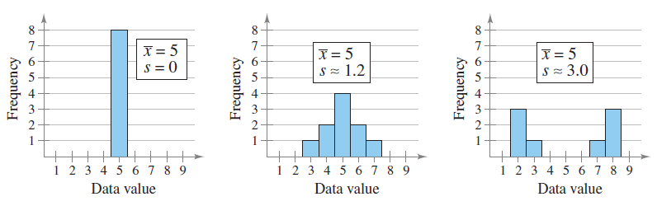
Interpreting Standard Deviation

Slide 10
Standard Deviation: True Indicator of Homogeneous/Heterogeneous Data
Consider blood sugar levels of two groups of people:
A = 125, 118, 121, 123, 119, 122, 117, 121, 124, 116, 120, 122, 119, 124, 118, 120, 123, 122, 118, 121
Mean = 120 mg/dL, SD = 2.35 mg/dL
Most close to the mean (Fit)
B = 150, 90, 115, 145, 118, 112, 135, 121, 117, 122, 119, 128, 115, 145, 120, 90, 155, 135, 122, 115
Mean = 120 mg/dL, SD = 17.31 mg/dL
Some close to the mean (Fit), some away from the mean (Unfit)

Slide 11
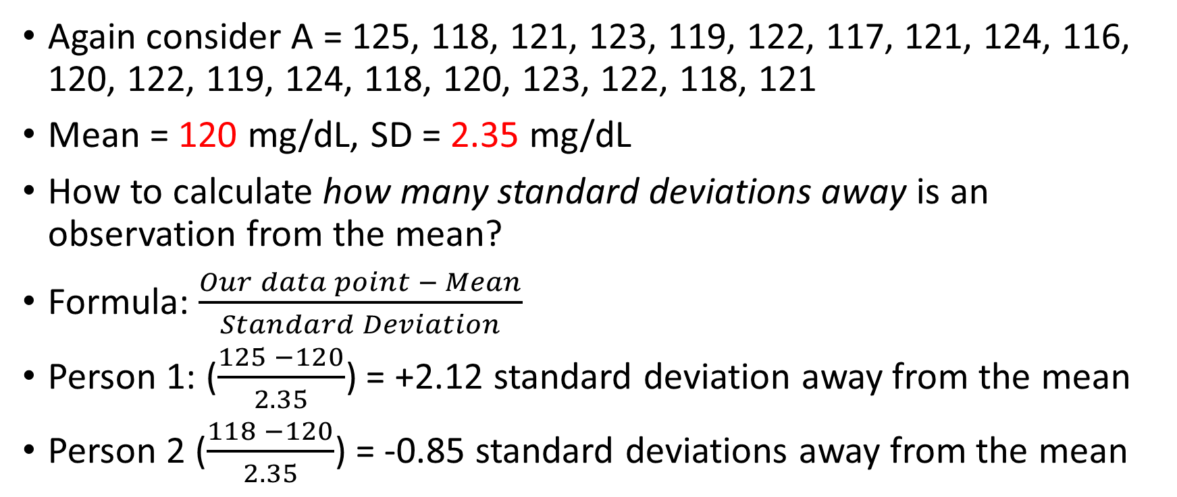
Interpreting Standard Deviation
Again consider A = 125, 118, 121, 123, 119, 122, 117, 121, 124, 116, 120, 122, 119, 124, 118, 120, 123, 122, 118, 121
Mean = 120 mg/dL, SD = 2.35 mg/dL
How to calculate how many standard deviations away is an observation from the mean?
Formula: $\frac{Our data point − Mean}{Standard Deviation}$
Person 1: ($\frac{125 −120}{2.35}$) = +2.12 standard deviation away from the mean
Person 2 ($\frac{118 −120}{2.35}$) = -0.85 standard deviations away from the mean

Slide 12
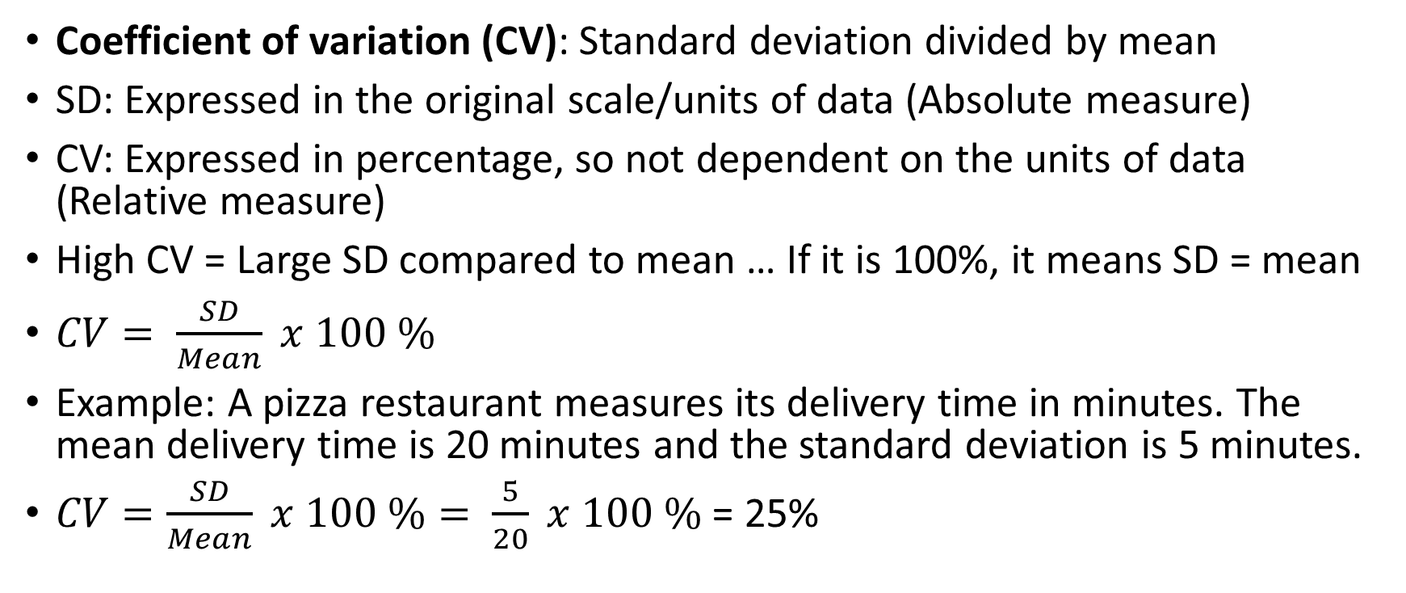
Coefficient of Variation (CV)
Coefficient of variation (CV): Standard deviation divided by mean
SD: Expressed in the original scale/units of data (Absolute measure)
CV: Expressed in percentage, so not dependent on the units of data (Relative measure)
High CV = Large SD compared to mean … If it is 100%, it means SD = mean
$CV= \frac{SD}{Mean} x 100 \%$
Example: A pizza restaurant measures its delivery time in minutes. The mean delivery time is 20 minutes and the standard deviation is 5 minutes.
$CV=\frac{SD}{Mean} x 100 \%= \frac{5}{20} x 100 \%$ = 25%

Slide 13
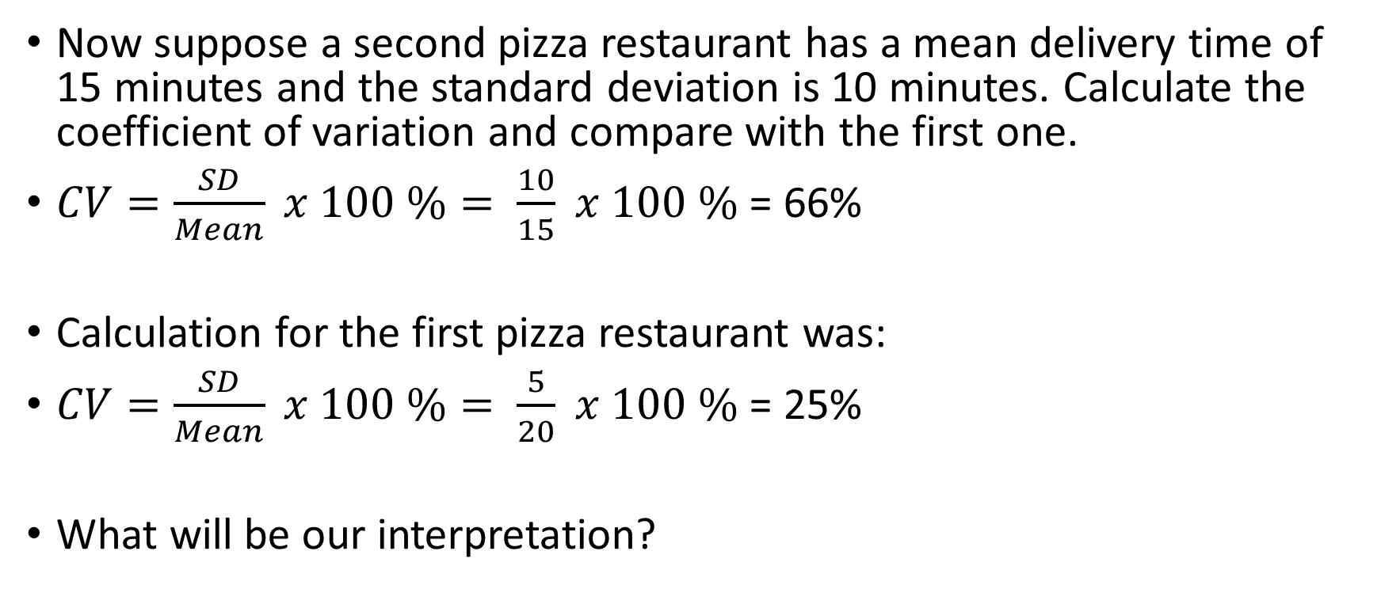
Coefficient of Variation (CV)
Now suppose a second pizza restaurant has a mean delivery time of 15 minutes and the standard deviation is 10 minutes. Calculate the coefficient of variation and compare with the first one.
$CV=\frac{SD}{Mean} x 100 \%= \frac{10}{15} x 100 \%$ = 66%
Calculation for the first pizza restaurant was:
$CV=\frac{SD}{Mean} x 100 \%= \frac{5}{20} x 100 \%$ = 25%
What will be our interpretation?

Slide 14
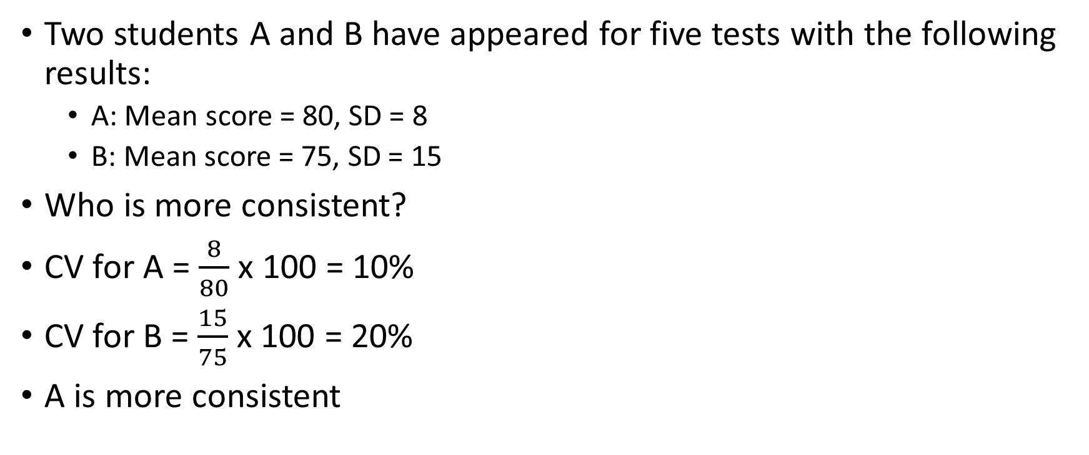
Problem
Two students A and B have appeared for five tests with the following results:
A: Mean score = 80, SD = 8
B: Mean score = 75, SD = 15
Who is more consistent?
CV for A = $\frac{8}{80}$ x 100 = 10%
CV for B = $\frac{15}{75}$ x 100 = 20%
A is more consistent

Slide 15
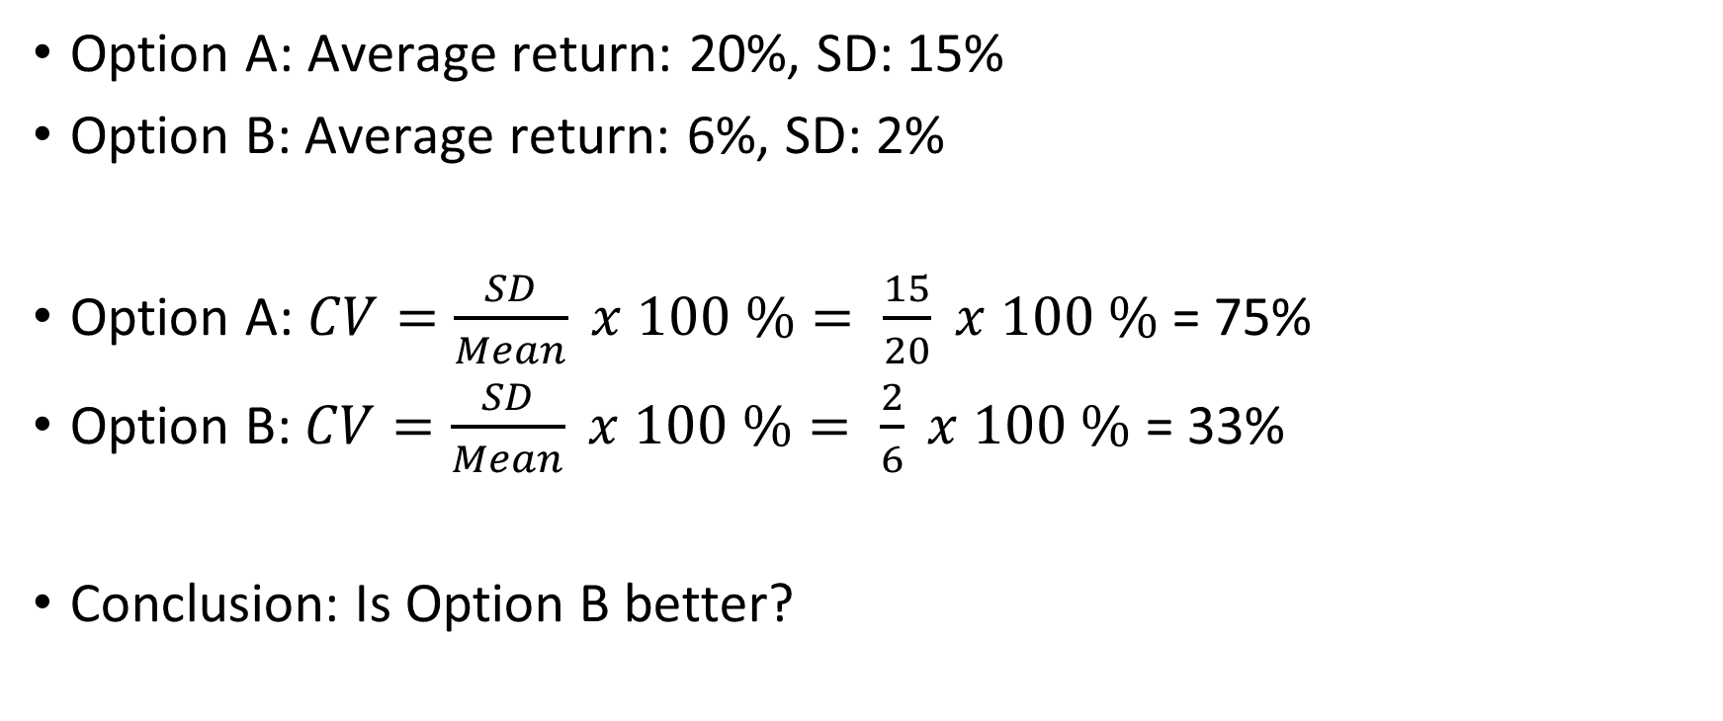
Making Investment Decisions
Option A: Average return: 20%, SD: 15%
Option B: Average return: 6%, SD: 2%
Option A: $CV=\frac{SD}{Mean} x 100 \%= \frac{15}{20} x 100 \%$ = 75%
Option B: $CV=\frac{SD}{Mean} x 100 \%= \frac{2}{6} x 100 \%$ = 33%
Conclusion: Is Option B better?

Slide 16
Skewness

Slide 17
Skewness can be Confusing!
Skew: Represents the asymmetry of a distribution around its mean
Skew = Where is the skew, not where is the data
Students appearing in an Examination
No-skew: Student marks are evenly distributed
Right-skew: Most students get low marks => Long tail to the right (higher values)
Left-skew: Most students get high marks => Long tail to the left (lower values)
Skew | Tail | Most Data | Interpretation
Right (Positive) | On the Right | On the Left | Most values are low
Left (Negative) | On the Left | On the Right | Most values are high

Slide 18
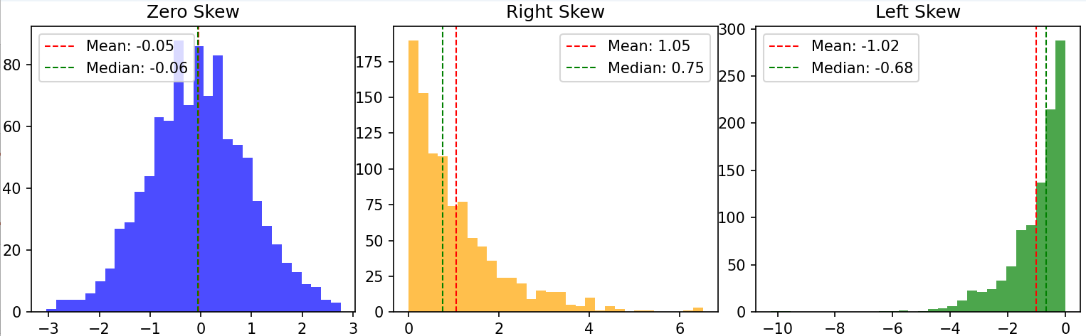
Skew
C:\code\Data Analytics\skew-visualize.py
Zero-skew (No-skew): Mean = Median
Characteristic | Right (Positive) Skew | Left (Negative) Skew
Key feature | Most values are on the lower side, a few on are the higher side | Most values are on the higher side, a few are on the lower side
Statistics | Mean > Median | Mean < Median
Mean | Skewed to the right | Skewed to the left
Tail | Comes later - On the right (Represents high values) | Comes first - On the left (Represents low values)
More data points | On the left | On the right
Outliers | On the right | On the left
Ratings Example | Most people give ratings of 1 or 2 out of 5 | Most people give ratings of 4 or 5 out of 5
Example | Incomes of people | Ages at the time of death
Why? | Most people have low incomes, Very few have very high income | Most people would die in older age, Very few children die

Slide 19
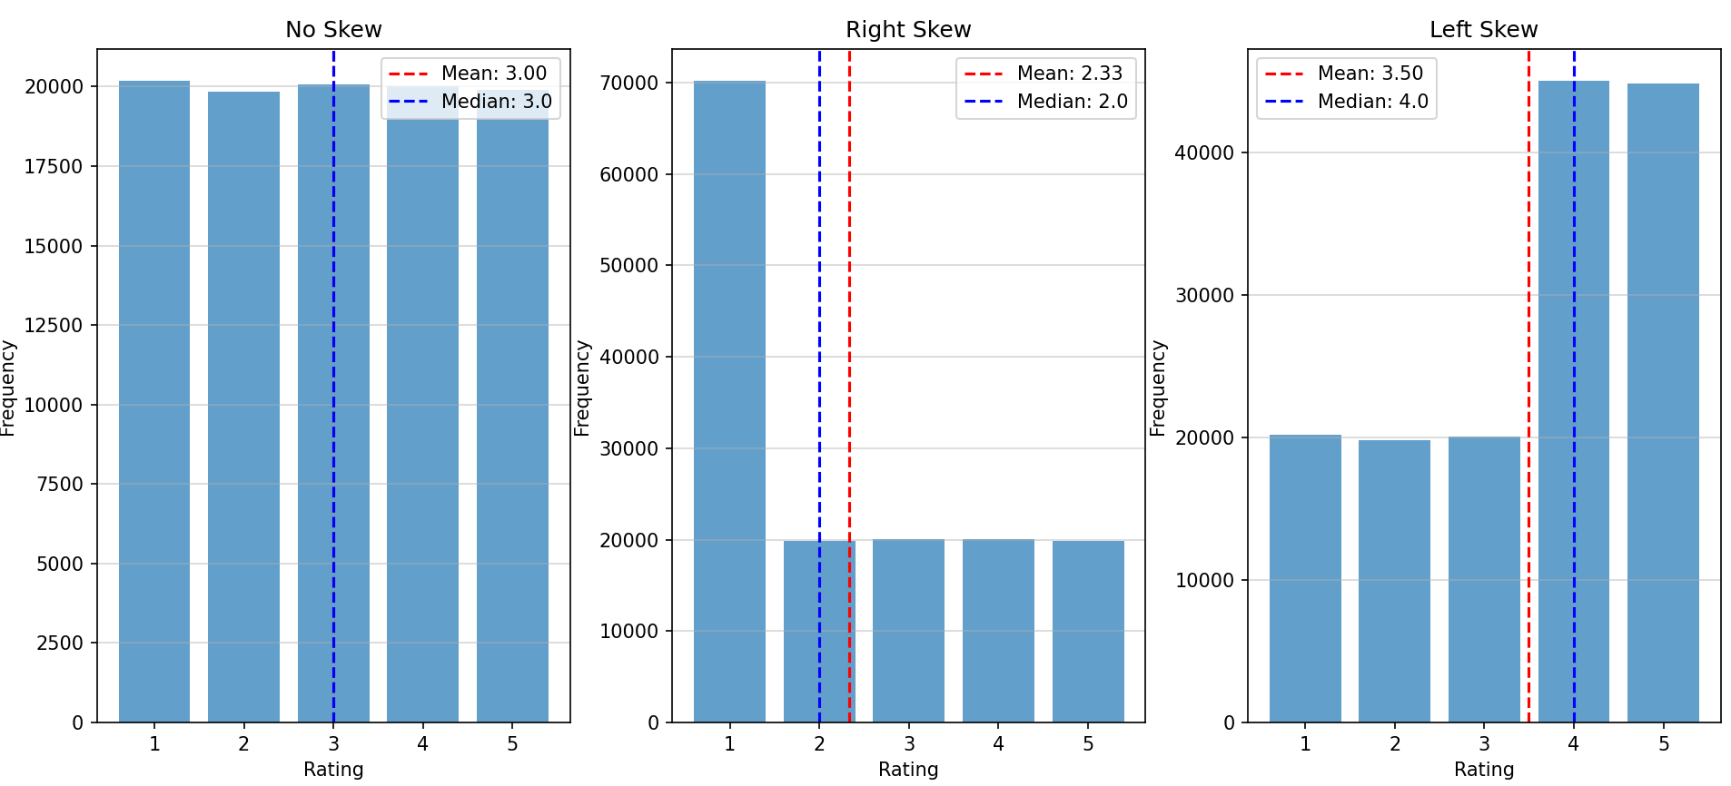
Simple Ratings Example (C:\code\Data Analytics\Skew-dummy.py)
Consider 1 lakh people giving ratings on a scale of 1-5
No-skew: All ratings occur almost with the same frequency
Right-skew: Most people give low ratings (1/2)
Left-skew: Most people give high ratings (4/5)

Slide 20
Skew Real-Life Examples
Right Skew (More data points are on the left)
C:\code\Data Analytics\ skewness-airlines-distance.py
Left Skew (More data points are on the right)
C:\code\Data Analytics\ skewness-airlines-onboard-service.py (Note: The dataset is different here)

Slide 21
Skewness Formulae
Pearson's First Coefficient of Skewness (Mode Skewness): (Mean - Median) / Standard Deviation
Another variation: 3 (Mean - Median) / Standard Deviation
Fisher-Pearson Coefficient of Skewness (Moment Skewness): (Σ(xi - Mean)^3 / n) / [(Σ(xi - Mean)^2 / n)^(3/2)]
Quantile-Based Skewness: (Q3 + Q1 - 2 * Median) / (Q3 - Q1)

Slide 22
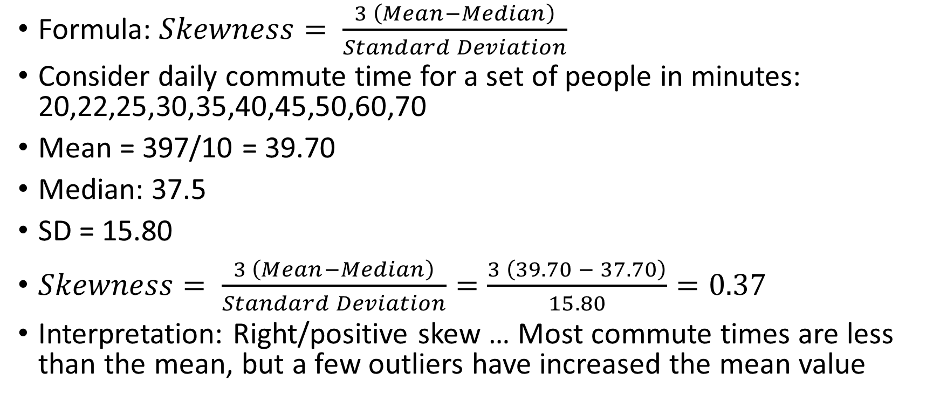
Pearson’s Coefficient of Skewness
Formula: $Skewness= \frac{3 \left(Mean−Median\right)}{Standard Deviation}$
Consider daily commute time for a set of people in minutes: 20,22,25,30,35,40,45,50,60,70
Mean = 397/10 = 39.70
Median: 37.5
SD = 15.80
$Skewness= \frac{3 \left(Mean−Median\right)}{Standard Deviation}=\frac{3 \left(39.70 − 37.70\right)}{15.80}=0.37$
Interpretation: Right/positive skew … Most commute times are less than the mean, but a few outliers have increased the mean value

Slide 23
Kurtosis

Slide 24
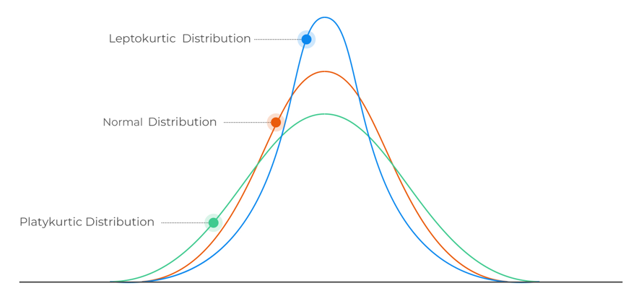
Kurtosis
Kurtosis: Describes the shape of the probability distribution of a real-valued random variable

Slide 25
Kurtosis Interpretation
Leptokurtic (Positive Kurtosis)
Heavy tails and a sharp peak
Kurtosis values higher than 3
Data has more outliers or extreme values than a normal distribution
Mesokurtic (Normal Kurtosis)
A distribution with the same kurtosis as a normal distribution (kurtosis = 3)
Tails and peak are similar to a normal distribution
Platykurtic (Negative Kurtosis)
A distribution with lighter tails and a flatter peak than a normal distribution
Kurtosis values lower than 3
Data has fewer outliers than a normal distribution

Slide 26
Descriptive Statistics Code
Calculate various descriptive statistics for the tip column of the tips dataset (Dataset name tips.csv)
C:\code\Data Analytics\descriptive_statistics_tips.py
Assignment: Calculate various descriptive statistics and visualize the distribution for the Official Time column of Boston Marathon 2015, 2016, 2017 as a single dataset (Dataset names: marathon_results_2015.csv, marathon_results_2016.csv, marathon_results_2017.csv)
C:\code\Data Analytics\ descriptive_statistics_boston_marathon.py

Slide 27
Covariance

Slide 28
Covariance
Covariance: Quantifies how changes in one variable relate to changes in another
Scale:
Covariance: Units of what we are measuring (difficult to interpret)
Correlation: -1 and +1 (easy)
Example:
As area increases, price increases: But by how much? … Covariance
Area of the House | Price of the House
1200 | 75 lakhs
1300 | 90 lakhs
1500 | 1.10 crores

Slide 29
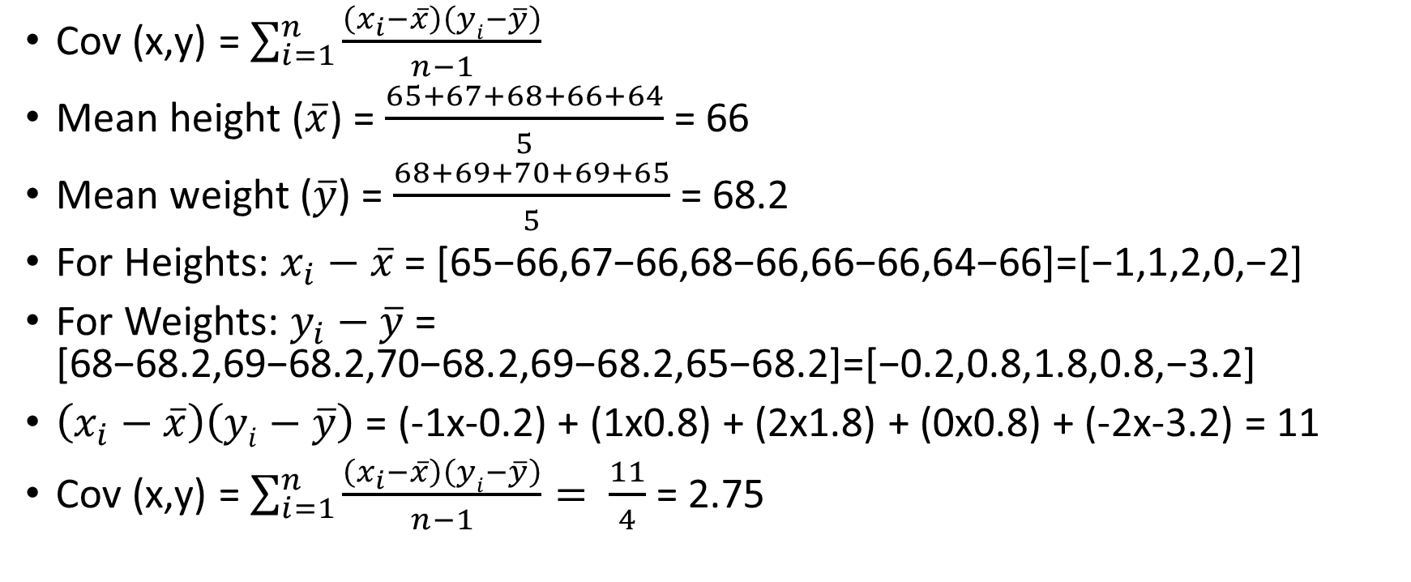
Covariance Example
Height | Weight
65 | 68
67 | 69
68 | 70
66 | 69
64 | 65
Cov (x,y) = $\sum_{i=1}^{n}{\frac{\left(x_{i}−\overline{x}\right)\left(yi−\overline{y}\right)}{n−1}}$
Mean height ($\overline{x}$) = $\frac{65+67+68+66+64}{5}$ = 66
Mean weight ($\overline{y}$) = $\frac{68+69+70+69+65}{5}$ = 68.2
For Heights: $x_{i}−\overline{x}$= [65−66,67−66,68−66,66−66,64−66]=[−1,1,2,0,−2]
For Weights: $y_{i}−\overline{y}$= [68−68.2,69−68.2,70−68.2,69−68.2,65−68.2]=[−0.2,0.8,1.8,0.8,−3.2]
$\left(x_{i}−\overline{x}\right)\left(yi−\overline{y}\right)$ = (-1x-0.2) + (1x0.8) + (2x1.8) + (0x0.8) + (-2x-3.2) = 11
Cov (x,y) = $\sum_{i=1}^{n}{\frac{\left(x_{i}−\overline{x}\right)\left(yi−\overline{y}\right)}{n−1}}= \frac{11}{4}$ = 2.75

Slide 30
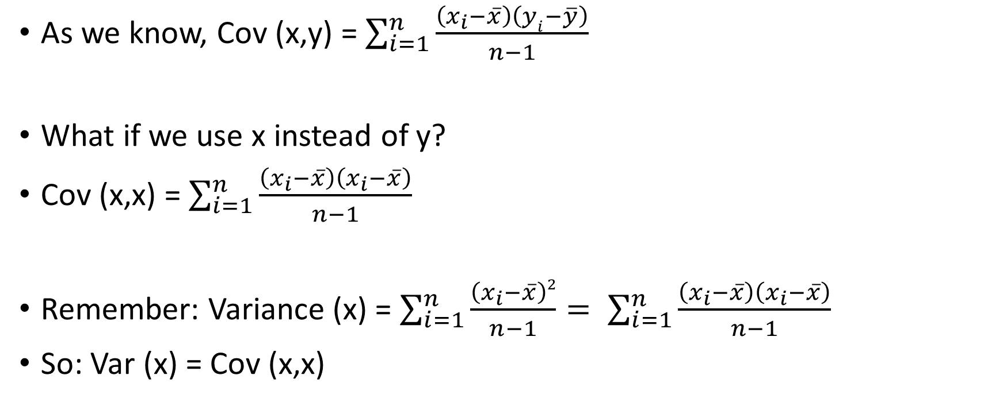
Covariance and Variance
As we know, Cov (x,y) = $\sum_{i=1}^{n}{\frac{\left(x_{i}−\overline{x}\right)\left(yi−\overline{y}\right)}{n−1}}$
What if we use x instead of y?
Cov (x,x) = $\sum_{i=1}^{n}{\frac{\left(x_{i}−\overline{x}\right)\left(x_{i}−\overline{x}\right)}{n−1}}$
Remember: Variance (x) = $\sum_{i=1}^{n}{\frac{\left(x_{i}−\overline{x}\right)2}{n−1}}= \sum_{i=1}^{n}{\frac{\left(x_{i}−\overline{x}\right)\left(x_{i}−\overline{x}\right)}{n−1}}$
So: Var (x) = Cov (x,x)

Slide 31
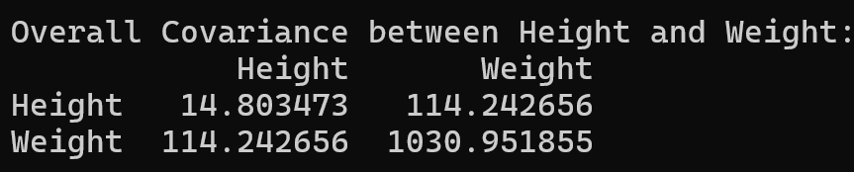
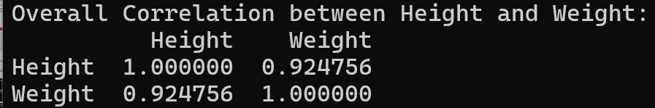
Covariance Example
C:\code\Data Analytics\correlation_covariance_height_weight.py
Diagonal elements: Variance of the variable (Height: 14, Weight: 1030)
Off-diagonal elements: Covariance between the two variables (114)
Since 114 > 0: As height increases/decreases, so does weight
Covariance = 114: No real interpretation on its own
But Correlation = 0.92: Very easy to interpret

Slide 32
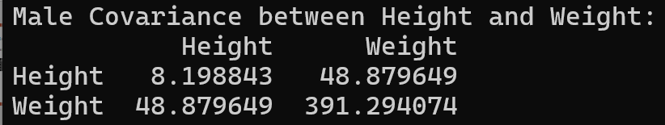
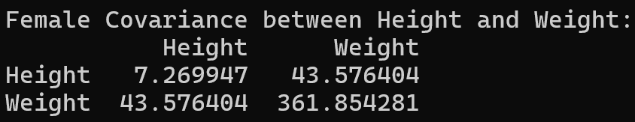
Covariance Interpretation
Compare covariance for three cases: (1) overall (2) males (3) females
Overall covariance = 114, For males = 48, For females = 43
Other statistics (Calculated separately):
male records: 5001, average height: 69, average weight: 187
female records: 5001, average height: 63, average weight: 135
Heights and weights are positively related in all three cases
Gender difference: Males are consistently taller and have more weight
So, although within group covariances are low, difference in means contributes to a higher overall covariance
That is, higher covariance pulls the lower covariance to a higher value (See next slide)

Slide 33
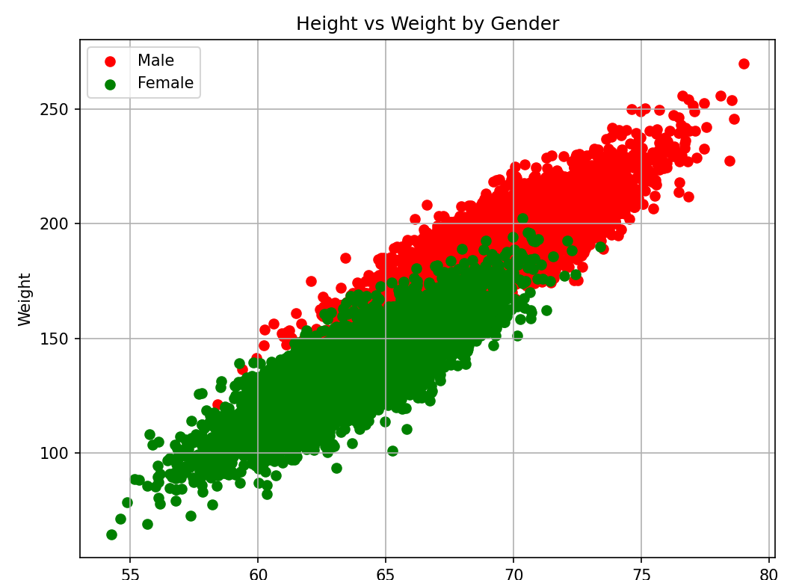
Covariance Interpretation
Plotting all data points: C:\code\Data Analytics\scatter_plot_heights_weights.py
Higher covariance in male records pulls lower covariance of females records to a higher side

